Slide 1
Associated Students
2010-2011 Year End Report

Slide 2
Mission
Our mission is to effectively represent student needs, keep students informed of student related issues, and promote cultural, social, and leadership opportunities for all students.

Slide 3
AS Core Staff
Kelly Munson, AS & Student Activities Advisor
Donna Tibbitts, Student Activities Secretary
Allison Phelps, AS Secretary
Yvette Zuniga, Student Activities Specialist
Cameron Hoffman, Lisa Dayoan & Janet Larson,
Student Activity Card Producers

Slide 4
Student Program Assistants
Culture & Community Center
Fox Brown
Becca Schwalm
Gisella Williams
Ja’Quan Sayres
Sustainability Resource Center
Megan Luke
Cyrus Fountain
Abigail Bruner
Robbie Reaves
Hallie Will

Slide 5
AS Officers
President, Eric Chisler
Vice President – Internal Affairs, Tony Gamboa
Vice President – External Affairs, Cameron Hoffman
Student Trustee, Janell Snead
Business Affairs Director, Steven Husar
InterClub Council Director, Angela Johnson
Academic Affairs Director, Sam Chan
Health & Wellness Director, Morgan
Satelite Campuses Director, Josie Hall
Social Director, Ai Iwano
Cultural Director, Mark & Dwayne Edwards
Sustainability Director, Jesse Lyon-Cunningham
Legislative Analyst, Rebecca Hernandez
Publicity Director, Becca Schwalm & Ambrosia Krinsky
Parliamentarian, Evin Sanders

Slide 6
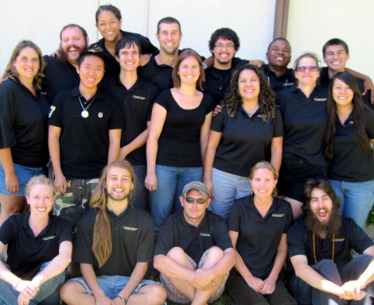

Slide 7
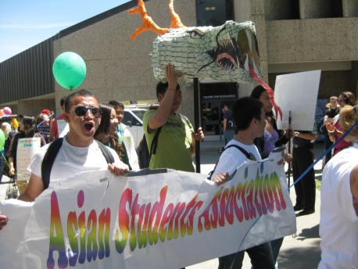
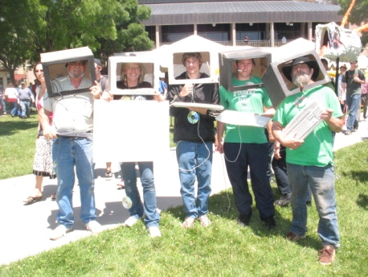
Campus Clubs
American Medical Student Association
Anthropology Club
Applied Science Club
Asian Student Association
Black Student Union
Butte College Ag Ambassadors
Butte College Investor’s Club
Butte College Motorsport Club
Butte College Sports Medicine Club
Butte College Veterans Organization
Butte Dance and Creative New Experiences
CA Landscape Contractors Association-Student Chapter
Ceramic Art Club
Chico Skeptics/Butte College Chapter
Collegiate Branch of American Society of Horticulture Science
Third Wave Feminist Club
Students in Free Enterprise
Computer Science Advisory Club
Culture & Civilization Club
Drama Club
Environmental Horticulture Club
Fashion Artists of Butte College
Friends of the Refuge
Gay-Straight Alliance
International Association of Administrative Professionals
International Club
Latter-Day Saints Student Association
MEChA Club
MESA Club
Music & Audio Production Club
National Student Nursing Association
Phi Theta Kappa (Beta Theta Kappa Chapter)
Psychology Club
Roadrunner Tae Kwon Do
Student Alliance for Sustainability

Slide 8
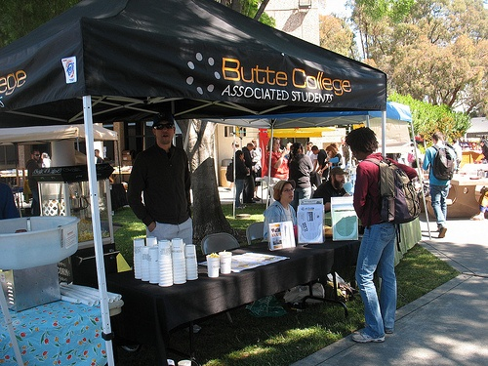
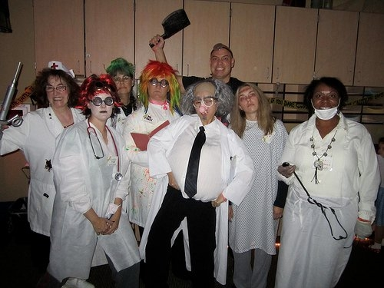
AS Events
AS Elections
Blood Drives (8)
Welcome Week
Harvest Festival
Diversity Summit
Campus BBQ & Parade
Campus Center Grand Opening
Rattlesnake Days / Spring Carnival
Wired! Up Music Series
Wellness Week
Valentine’s Day fun
Butte College Family Music Festival
Earth Day Festival
Student Awards Celebration
Club Promotion Week
Club Challenge Week
Chico Center Spirit Day
AS Give Away Days

Slide 9
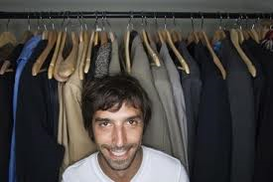
AS Special Project Support
Campus Graphics computers $4.5K
Butte College Professional Clothing Closet $500

Slide 10
AS Initiatives (partial list)
Region 1 Summit – 48 students from 8 colleges
Culture & Community Center $15K
Gender Neutral Bathrooms
Center for Well-Being
Chico Center bus accommodations & seating $4+K
Zimride!! $10K
March in March – 42 students & Trash/Recycling Clean up
Sponsored 3 students to Bioneers Conference
Happiness Project – 100 surveys, 1,000 direct contact through workshops & campus social contact
Created procedures & flow chart for directing student concerns
AS Street Team – 16 volunteers
Smart ICC/AS Lounge
AS meetings now paperless

Slide 11
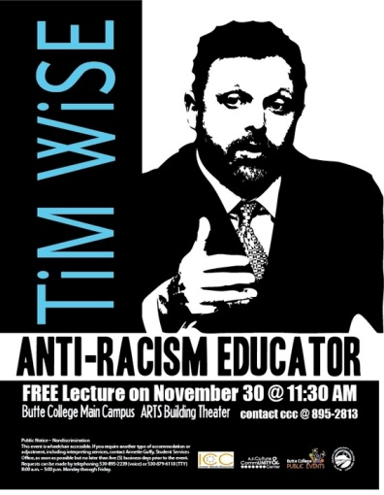
AS Co-Sponsored Events
*Received part or full funding from the AS
Tim Wise (speaker)
Circle of Stones Women’s Gathering
Hispanic Heritage Month Celebration
Domestic Violence Awareness Month event
Veterans Day Celebration
Dia de los Muertos (Day of the Dead)
Human Rights Day
National Library Week
Campus Clean Up Day

Slide 12
Annual Campus Program Support
Coyote Gallery ($1,500)
Emergency Book Loan Fun ($1,500)
Food Pantry ($1,500)
Athletics ($1,500)
Roadrunner Rush ($1,000)
Make a Difference Day ($1,000)
Safe Place ($1,500)
Theater ($1,000)

Slide 13
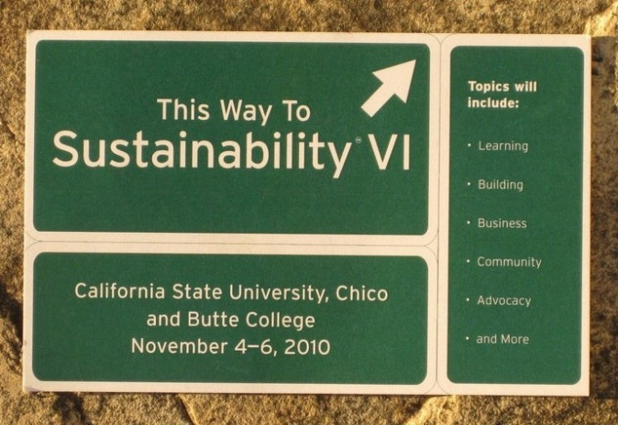
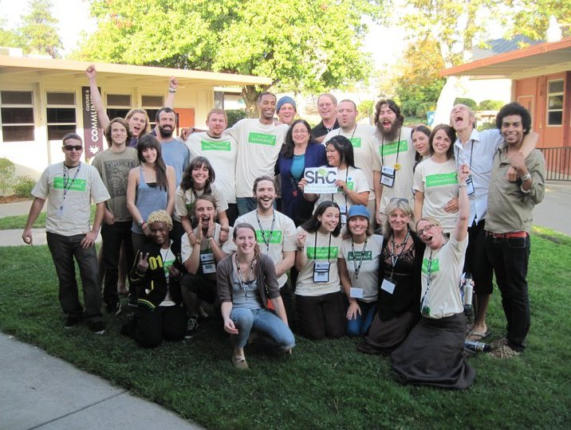
Community Partnerships
This Way to Sustainability Conference (with CSUC)
Shamrock Shuffle (with CSUC)
City of Chico Earth Day Festival (with Butte Environmental Council)

Slide 14
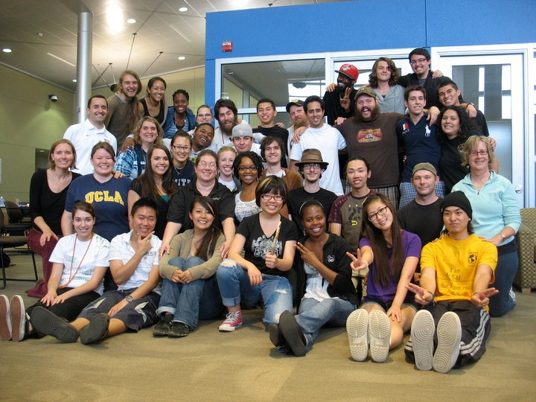
Leadership Development
Summer Leadership Academy (June) – hosted 45 AS, Club & Orientation leaders
Student Senate for California Community Colleges (SSCCC) General Assemblies (2)
California Community Colleges Student Affairs Association (CCCSAA) Student Leadership Conference
Inter-Club Council Training Day – Hosted 78 students
Diversity Summit – Hosted 97 students
Region 1 Summit – Hosted 48 students
Sent AS Cultural Director Western Regional LGBTQIAA College Conference

Slide 15
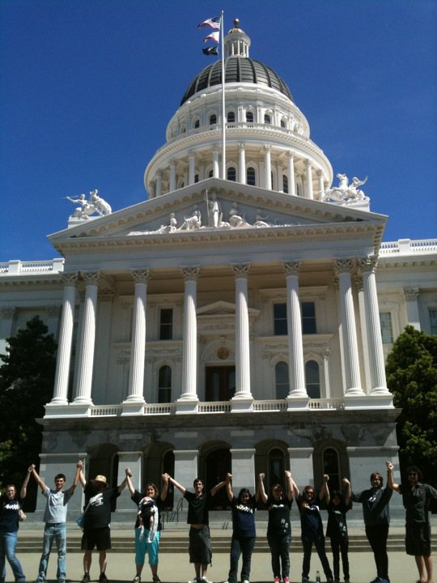
State-wide Involvement
March in March Day at the Capitol
Hands Across California event
Student Senate for California Community Colleges (SSCC) – regional and statewide representation
California Community College Student Affairs Association
Visited 4 other campuses
Two Region 1 Officers from BCAS

Slide 16
Student Ambassador Program
We do our best to make sure the student voice is heard when making decisions on campus. We have placed students on the following committees during one or both semesters:
Board of Trustees
Academic Senate
Participatory Governance Committee
Sustainability Steering Committee
Diversity Committee
Academic Council
Distance Learning Committee
Curriculum Committee
Public Events Committee
Community Youth & Alcohol Committee
Measure A Bond Oversight Committee
Judicial Council

Slide 17
AS Programs & Special Projects
A.S. Sustainability Resource Center
A.S. Culture & Community Center
A.S. Street Team
Student Ambassador Program
Student Activity Cards
Student Handbooks
Campus Coupon Books
Graduation Pledge of Environmental & Social Responsibility
Zimride Ride Share Program

Slide 18
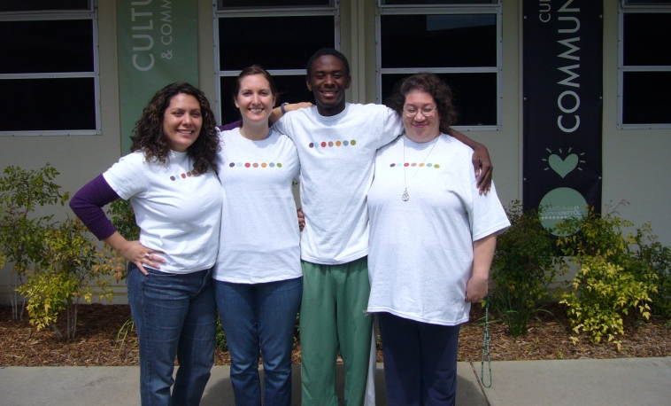
AS Culture & Community Ctr.
A.S. Culture & Community Center Grand Opening Celebration
Diversity Summit
Dia de los Muertos (day of the dead)
Co-Sponsor, Veteran’s Day Celebration
Velt Presentation
Co-Sponsor, International Education Week Potluck
Co-Hosted the International Film Festival
Tim Wise Anti-Racism Presentation
Multiple film showings & International Week Film Festival
Host for Club Meetings: Phi Theta Kappa Club, Anthropology Club, Gay Straight Alliance and Cultures & Civilizations Club
Japanese & German Conversation Hour
Diversity Days events
Yvette Zuniga to National Conference on Race & Ethnicity Conference

Slide 19
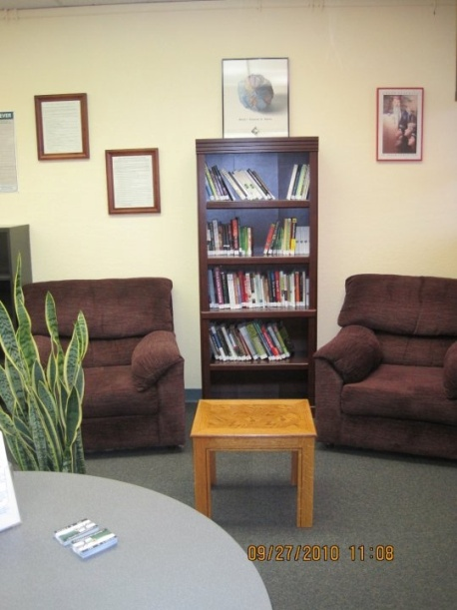
AS Sustainability Resource Ctr.
AS Sustainability Director attended UC-CSU-CCC Conference
Butte College Campus Sustainability Day
This Way to Sustainability Conference
Butte College Earth Day Festival
Power Shift, Washington D.C.
California Student Sustainability Coalition Convergence, UC Davis
Graduation Pledge for Social & Environmental Responsibility

Slide 20
Public Events Grants Total $8,080
Culture & Community Center
$ 1,000.00
Speaker and educator on antiracism topics
Phi Theta Kappa
$ 100.00
Branches of Inspiration – Literary Magazine
Welcome Center
$ 1,000.00
International Education Week
Black Student Union
$ 380.00
Black History Month Poetry Slam
Student Activities & Staff Development
$ 800.00
Wellness Week 2011
Cultural & Community Center
$ 450.00
“Wired Up” Music Series
Butte Players
$ 1,000.00
Play performances
Gay-Straight Alliance Club
$ 700.00
Drag Ball
Safe Place
$ 600.00
Sexual Assault Awareness Month
Butte College Library
$ 500.00
Library Awareness Week
Student Activities Office
$ 550.00
Circle of Stones Women’s Gathering
Sustainability Resource Center
$ 1,000.00
2011 Earth Days

Slide 21
AS Grants Total $16,700
Fall 2010
MESA
$2,000
Be Well Project
MESA
$2,200
Student Leadership Retreat
Black Student Union
$2,000
NCORE Conference
Black Student Union
$700
Shades of Success Conference for Men and Women
International Club
$1,700
Student Trip to Monterey
Center for Well Being
$900
Yoga & Meditation Equipment and Presenter Series
Spring 2010
Phi Theta Kappa
$750
Student Leadership Conference
MESA
$2,000
Educational Speaker Series
Diversity Committee
$1,500
Unlearning Racism Retreat
International Club
$2,000
Student Trip to San Francisco
International Association of Administrative Professionals
$1,250
Student Training in Sacramento

Slide 22
InterClub Council Grants Total $ 14, 912.12
Fall 2010 ICC Grants
Inter Club Council
$1,300
Club Promotion Days Budget
Inter Club Council
$875
Club Training Day
Cultures and Civilization Club
$350
T-shirts
Student Veterans Organization
$267
T-shirts
Butte College Autism Activism
$100
Autism Workshop
Student Veterans Organization
$500
Veterans Day Celebrations
Inter Club Council
$250
Attendance Drawing Scholarship
Inter Club Council
$350
ICC Representative Shirts
Black Student Union
$1,000
Tim Wise Presentation
Butte Investment Club
$225
Online Investment Game
Phi Theta Kappa
$700
Literary Magazine
Ag Ambassadors
$248
T-shirts
Gay Straight Alliance
$704
Queer DVD Collection
Butte College Horticulture Club
$350
T-Shirts
Phi Theta Kappa Proposal
$300
Chocolate Candy Bars
Inter Club Council
$1,000
Club Social
Spring 2011 ICC Grants
Inter Club Council
$1,052.50
Club Promotion Days
Inter Club Council
$674
Club Training Day
Inter Club Council
$175
Attendance Drawing
STOP (Stop Trafficking of Persons)
$500
T-Shirts, Educational Materials
Cultures and Civilizations Club
$540
Trip to Ashland
Asian Student Association
$212.72
T-shirts
Gay Straight Alliance
$1,000
Drag Ball
Applied Science Club
$288.90
T-Shirts
International Association of Administrative Professionals
$250
Silent Auction
Inter Club Council
$700
Club Challenge Week
Inter Club Council
$50
Outstanding Advisor Award
Inter Club Council
$500
Outstanding Club Member Award
Inter Club Council
$450
Leadership Academy

Slide 23
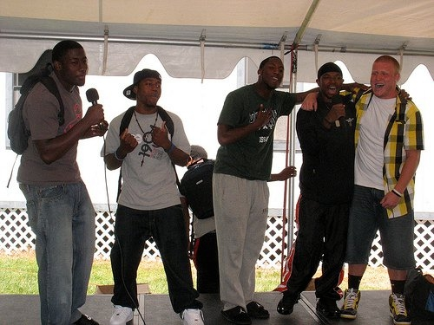
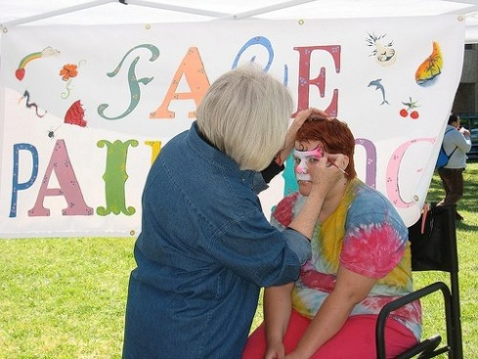
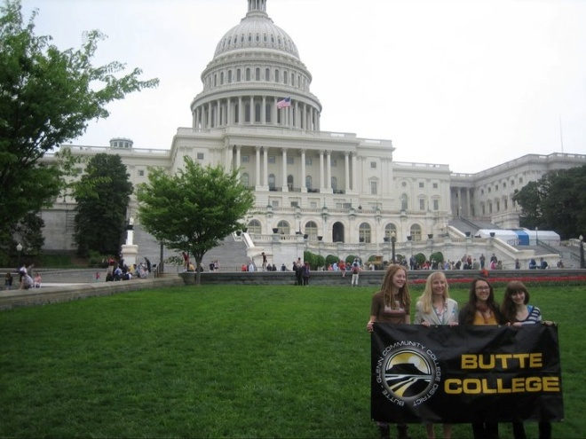
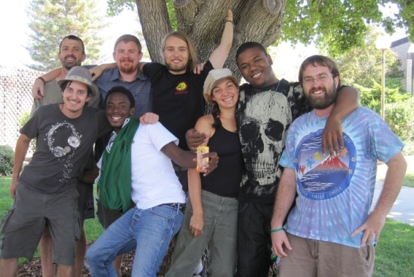
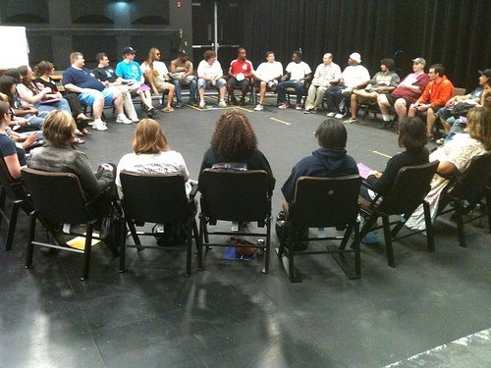
We love what we do!

Slide 24
We couldn’t have done it without you! Thank you!
We offer a big, heartfelt thank you to all
the individuals, constituency groups and departments that have supported us
though the year.

